Slide 1
JOURNEY MAP 2026
Journey Map 2026: Build Your Vision & Purpose
Hosted by Dr. L, Founder, Church Girls, Inc.

Slide 2
Welcome to Your 2026 Journey
You’re in the right place
Today is about clarity, confidence, and direction
This is your space to reflect and design your year

Slide 3
What We Will Do Today
Clarify your vision and your purpose
Identify your top priorities
Create an aligned action plan
Build your 2026 roadmap

Slide 4
Set Your Intention
Why are you here today? What do you want more of in 2026?
Choose one word for your year

Slide 5
Emotional Visioning
How Do You Want 2026 to Feel?
What feelings do you want to experience more often?
What energy do you want to bring into the year?

Slide 6
Reflecting on 2025
Looking Back to Look Forward
What worked well?
What drained you?
What did you learn?

Slide 7
Lessons You’re Bringing Into 2026
Your 2025 Takeaways
What did last year teach you?
What patterns do you want to break?
What strengths do you want to build on?

Slide 8
Your 2026 Vision
Imagine Your Best Year
What does your ideal 2026 look like?
What does success feel like?
Who are you becoming?

Slide 9
Values That Guide You
Your Core Values
What matters most to you?
What principles will guide your decisions?

Slide 10
Life is a Journey. Let’s Build Your Roadmap
Your 2026 Roadmap Includes:
You
Input
Output
Output
Output
Quarterly milestones
Skills/resources needed
Support systems
Accountability structure-
  You Don’t Have to Do It Alone. Who can support you? What systems will keep you on track? How will you check in with yourself?

Slide 11
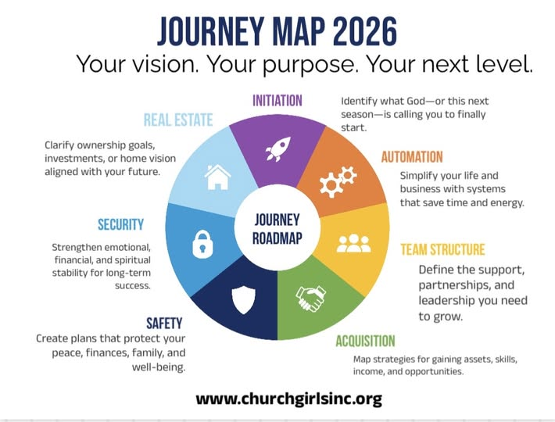
If Something Feels Off…
Adjust & Refine
Revise It
Simplify It
Realign it

Slide 12
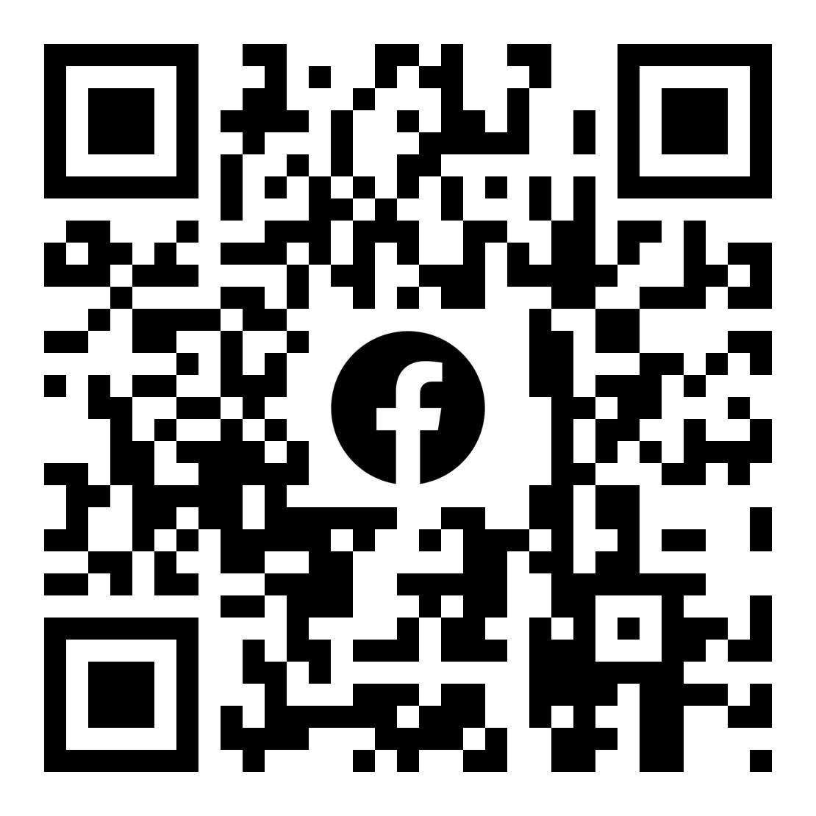
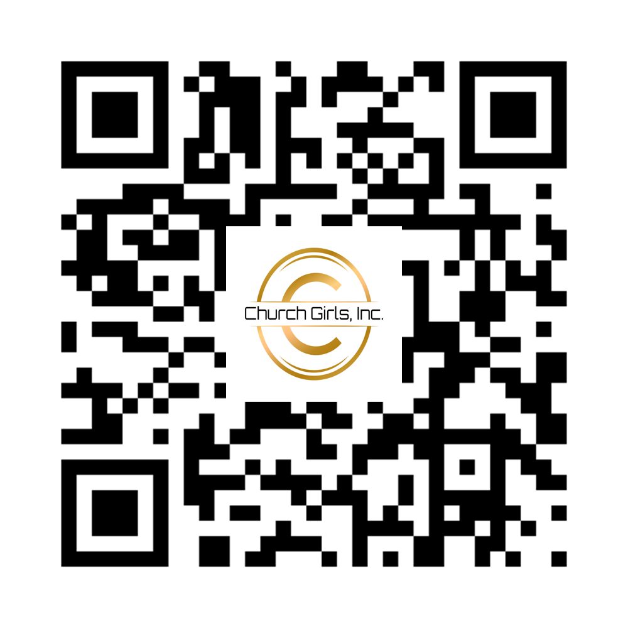
Thank you!

